Slide 1
MODULE - 6

Slide 2
8051-TIMERS/COUNTERS

Slide 3
Introduction
8051 has two Timers/Counters
Timer0/Counter0 and Timer1/Counter1
Both timer/counter is sixteen-bit Timer/Counter

Slide 4
Registers used
TMOD (Timer Mode Register)
TCON (Timer Control Register)
THx (Timer High Register)
TLx (Timer Low Register)
x = 0, Timer 0
X =1, Timer 1

Slide 5
TMOD Register
TIMER 1 |  |  |  | TIMER 0
GATE | C/T | M1 | M0 | GATE | C/T | M1 | M0
Gate: This bit indicates How to control the timer whether by software, or hardware. If we set this by 0 we can start and stop the timer by software(coding). If we set 1 timer is controlled by hardware. we have the dedicated pin in Port 0.
C/T: This bit used to select timer or counter. 0 for Timer and 1 for the counter.
M0, M1: These bits are used to select the timer modes like below.
M1 | M0 | MODE
0 | 0 | Mode 0: 13 bit mode (seldom used).
0 | 1 | Mode 1: 16-bit mode
1 | 0 | Mode 2: 8-bit mode (with auto-reload feature)
1 | 1 | Mode 3: 8-bit split timer

Slide 6
16-bit Time Mode (Mode 1)
Timer mode “1” is a 16-bit timer.
This is a very commonly used mode.
TLx is incremented from 0 to 255.
When TLx is incremented from 255, it resets to 0 and causes THx to be incremented by 1.
Since this is a full 16-bit timer, the timer may contain up to 65536 distinct values.
If you set a 16-bit timer to 0, it will overflow back to 0 after 65,536 machine cycles.
8-bit Time Mode (Mode 2)
Timer mode “2” is an 8-bit auto-reload mode.
When a timer is in mode 2, THx holds the “reload value” and TLx is the timer itself.
Thus, TLx starts counting up.
When TLx reaches 255 and is subsequently incremented, instead of resetting to 0 (as in the case of modes 0 and 1), it will be reset to the value stored in THx.

Slide 7
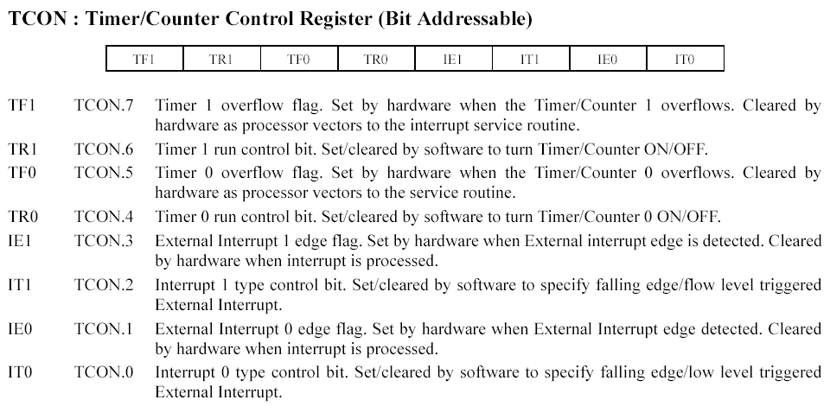
TCON Register

Slide 8
Initializing a Timer
First initialize the TMOD SFR
For example, if we are using with timer 0 we will be using the lowest 4 bits of TMOD.
The first two bits, GATE0 and C/T0 are both 0 since we want the timer to be independent of the external pins. 16-bit mode is timer mode 1 so we must clear T0M1 and set T0M0. Effectively, the only bit we want to turn on is bit 0 of TMOD.
TMOD=0x01;
Timer 0 is now in 16-bit timer mode. However, the timer is not running. To start the timer running we must set the TR0 bit we can do that by executing the instruction.
TR0=1;
Detecting Timer Overflow
while (TF0==0); for timer 0 overflow
0 | 0 | 0 | 0 | 0 | 0 | 0 | 1

Slide 9
In order to generate a delay of 1ms, the calculations using above steps are as follows.
N = 1ms/1.085μs ≈ 922.
M = 65536-922 = 64614 (decimal).
64614 in Hexadecimal = FC66h.
Load TH with 0xFC and TL with 0x66.

Slide 10
Write an 8051 C program to toggle all bits of P2 continuously every 500ms. Use Timer 1, mode 1 to create the delay.
Making TH and TL both zero means that the timer will count from 0000 to FFFF, and then roll over to raise the TF flag. As a result, it goes through a total of 65536 states.
Therefore, we have delay =
(65536 - 0) × 1.085 us = 71.1065ms.
71.1065ms * x =500ms
x = 500/71.1065 = 7

Slide 11
#include<reg51.h>
void T1M1Delay(void);
void main(void)
{
unsigned char x;
P2=0x55;
while(1)
{
P2=~P2;
for(x=0;x<7;x++)
T1M1Delay();
}
}
void T1M1Delay(void)
{
TMOD=0x10;
TH1=0x00;
TL1=0x00;
TR1=1;
while(TF1==0);
TF1=0;
TR1=0;
}

Slide 12
Example Assuming XTAL = 11.0592 MHz, write a program to generate a square wave of 50 Hz frequency on pin P2.3.
T = 1/50 Hz = 20 ms
1/2 of it for the high and low portions of the pulse = 10 ms
10 ms / 1.085 us = 9216
65536 - 9216 = 56320 in decimal = DC00H
TL = 00 and TH = DCH
The calculation for 12MHz crystal uses the same steps

Slide 13
Write an 8051 C program to create a frequency of 2500Hz on pin P2.7. Use Timer 1, mode 2 to create the delay.
Given frequency: 2500Hz
T = 1/2500 Hz = 400ms
1/2 of it for the high and low portions of the pulse = 200ms
200ms / 1.085 us = 184.33≈184
256 - 184 = 72 in decimal = 48H
TH = 48H

Slide 14
Assume that a 1-Hz external clock is being fed into pin T1(P3.5). Write a C program for counter 1 in mode 2 to count up and display the state of the TL1 count on P1. Start the count at 0H.
#include <reg51.h> void main(void) { T1=1; TMOD = 0X60; // mode 2 TH1 = 0; while(1) { do | { TR1=1; P1=TL1; } while(TF1==0); TR1=0; TF1=0; } }

Slide 15
Assume that a 1-Hz external clock is being fed into pin T0(P3.4). Write a C program for counter 0 in mode 1 to count up and display the state of the TL0 and TH0 registers on P2 and P1 respectively.
#include <reg51.h> void main(void) { T0=1; //make T0 an input TMOD=0x05; TL0=0; //set count to 0 TH0=0; //set count to 0 while(1) //repeat forever { do | { TR0=1; //start timer P1=TL0; //place value on pins P2=TH0; } while (TF0==0); //wait here TR0=0; // stop timer TF0=0; }

Slide 16
Blinking of LED - Hardware
void Delay(void)
{
int j;
int i;
for(i=0;i<10;i++)
{
for(j=0;j<10000;j++)
{
}
}
}
#include<reg51.h>
// special function register declarations
// for the intended 8051 derivative
sbit LED = P1^0; // Defining LED pin
void Delay(void); // Function prototype declaration
void main (void)
{
while(1) // infinite loop
{
LED = 0; // LED ON
Delay();
LED = 1; // LED OFF
Delay();
}
}

Slide 17
Serial Communication

Slide 18
Introduction
The microcontroller MCS51 has an inbuilt UART for carrying out serial communication. The serial communication is done in the asynchronous mode.
A serial port, like other PC ports, is a physical interface to establish data transfer between a computer and external hardware or device. This transfer, through a serial port, takes place bit by bit.
Bit Addressable: We can assign the values bit by bit. For example, for a single bit, we can set whether 1 or 0.
Byte Addressable: We can’t assign the values bit by bit. We can set only byte by byte.

Slide 19
Registers used for UART
SCON (Serial Control Register) – Bit Addressable
SBUF (Serial Buffer Register) – Byte Addressable
PCON (Power Control Register) – Byte Addressable

Slide 20
SCON (Serial Control Register)
SM0 | SM1 | SM2 | REN | TB8 | RB8 | TI | RI
SM0: Serial Port Mode Specifier 1 bit.
SM1: Serial port Mode Specifier 2-bit.
SM0 | SM1 | Mode | Baudrate
0 | 0 | Shift Register (Mode 0) | F_{osc}/12
0 | 1 | 8-bit UART (Mode 1) | Variable (Set by Timer 1)
1 | 0 | 9-bit UART (Mode 2) | F_{osc}/32 or F_{osc}/64
1 | 1 | 9-bit UART (Mode 3) | Variable (Set by Timer 1)

Slide 21
SM2: Multiprocessor communications bit.
Set/cleared by the program to enable multiprocessor communications in modes 2 and 3.
When set to 1 an interrupt is generated if bit 9 of the received data is a 1; no interrupt is generated if bit 9 is a 0.
If set to 1 for mode 1, no interrupt will be generated unless a valid stop bit is received.
Clear to 0 if mode 0 is in use.
REN: Receive enable bit.
Set to 1 to enable reception; cleared to 0 to disable reception.
TB8: Transmitted bit 8.
Set/cleared by the program in modes 2 and 3.
RB8: Received bit 8.
Bit 8 of received data in modes 2 and 3; stop bit in mode 1.
Not used in mode 0.
TI: Transmit Interrupt flag.
Set to one at the end of bit 7 time in mode 0, and at the beginning of the stop bit for other modes. Must be cleared by the program.
RI: Receive Interrupt flag.
Set to one at the end of bit 7 time in mode 0, and halfway through the stop bit for other moves. Must be cleared by the program.

Slide 22
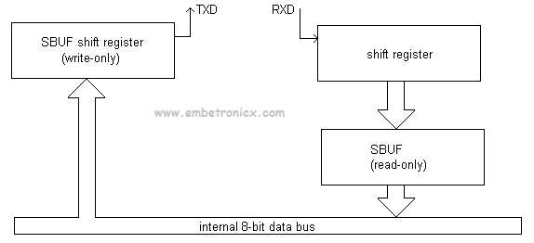
SBUF (Serial Buffer Register)
SBUF Register: For a byte of data to be transferred via the TxD line, it must be placed in the SBUF.
SBUF holds the byte of data when it is received by the MCS51’s RxD line.

Slide 23
PCON (Power Control Register)
SMOD | – | – | – | GF1 | GF0 | PD | IDL
SMOD: Double baud rate bit.
If Timer 1 is used to generate the baud rate and SMOD = 1, the baud rate is doubled when the serial port is used in modes 1, 2, or 3.
GF1: General-purpose flag bit.
GF0: General-purpose flag bit.
PD: Power Down bit.
Setting this bit activates the power-down operation in the 8051BH.
IDL: Idle Mode bit. Setting this bit activates the Idle Mode operation in the 8051BH.

Slide 24
Initialize the UART (Configuration)
Configure Serial Port mode 1 or 3.
Configure Timer 1 to Timer mode 2 (8-bit auto-reload).
Set TH1 to xxH to reflect the correct frequency for desired baud.
Set PCON.7 (SMOD) to double the baud rate.

Slide 25
Steps to send data serially in serial port communication
Set baud rate by loading TMOD register with the value 20H; this indicates timer 1 in mode 2 (8-bit auto-reload) to set baud rate.
The TH1 is loaded with proper values to set baud rate for serial data transfer.
The SCON register is loaded with the value 50H, indicating serial mode 1, where an 8-bit data is framed with start and stop bits.
TR1 is set to 1 to start timer 1.
Transmit Interrupt(TI) is cleared by CLR TI instruction.
The character byte to be transferred serially is written into SBUF register.
The TI flag bit is monitored to see if the character has been transferred completely.
To transfer the next byte, go to step 5.

Slide 26
Steps to receive data serially in serial port communication
Set baud rate by loading TMOD register with the value 20H; this indicates setting of timer 1 in mode 2 (8-bit auto-reload) to set baud rate.
The TH1 is loaded with proper values to set baud rate for serial data transfer.
The SCON register is loaded with the value 50H, indicating serial mode 1, where an 8-bit data is framed with start and stop bits.
TR1 is set to 1 to start timer 1.
Receive Interrupt(RI) is cleared by CLR RI instruction.
The RI flag bit is monitored to see if an entire character has been received yet.
When RI is raised, SBUF has the byte, its contents are moved into a safe place.
To transfer the next byte, go to step 5.

Slide 28
1. Find the TH1 value (in both decimal and hex ) to set the baud rate to each of the following. (a) 9600 (b) 4800 if SMOD=1. Assume that XTAL 11.0592 MHz
Solution:
With XTAL = 11.0592 and SMOD = 1,
we have timer frequency = 57,600 Hz.
(a) 57600 / 9600 = 6; so TH1 = -6 or TH1 = FAH
(b) 57600 / 4800 = 12; so TH1 = -12 or TH1 = F4H
2. Find the TH1 value (in both decimal and hex ) to set the baud rate to each of the following. (a) 9600 (b) 4800 if SMOD=0. Assume that XTAL 11.0592 MHz
(a) 28800 / 9600 = ?; so TH1 = ?
(b) 28800 / 4800 = ?; so TH1 = ?

Slide 29
Write a C program for 8051 to transfer the letter “A” serially at 4800 baud continuously.
#include <reg51.h>
void main(void){
TMOD=0x20; //use Timer 1, mode 2
TH1=0xFA; //4800 baud rate
SCON=0x50;
TR1=1; // start timer
while (1) {
SBUF=‘A’; //place value in buffer
while (TI==0);
TI=0;}
}

Slide 30
Write an 8051 C program to transfer the message “YES” serially at 9600 baud, 8-bit data, 1 stop bit. Do this continuously.
#include <reg51.h>
void SerTx(unsigned char);
void main(void){
TMOD=0x20; //use Timer 1, mode 2
TH1=0xFD; //9600 baud rate
SCON=0x50;
TR1=1; //start timer
while (1) {
SerTx(‘Y’);
SerTx(‘E’);
SerTx(‘S’);
}
}
void SerTx(unsigned char x){
SBUF=x;
//place value in buffer
while (TI==0);
//wait until transmitted
TI=0;
}

Slide 31
Program the 8051 in C to receive bytes of data serially and put them in P1. Set the baud rate at 4800; use 8-bit data, and 1 stop bit.
#include <reg51.h>
void main(void){
unsigned char mybyte;
TMOD=0x20; //use Timer 1, mode 2
TH1=0xFA; //4800 baud rate
SCON=0x50;
TR1=1; //start timer
while (1) { //repeat forever
while (RI==0); //wait to receive
mybyte=SBUF; //save value
P1=mybyte; //write value to port
RI=0;
}
}

Slide 32
Write an 8051 C Program to send the two messages “Normal Speed” and “High Speed” to the serial port. Assuming that SW is connected to pin P2.0, monitor its status and set the baud rate as follows:
SW = 0- 28,800 baud rate
SW = 1- 56K baud rate
Assume that XTAL = 11.0592 MHz for both cases.

Slide 33
#include <reg51.h>
sbit MYSW=P2^0; //input switch
void main(void){
unsigned char z;
unsigned char Mess1[]=“Normal Speed”;
unsigned char Mess2[]=“High Speed”;
//initialising serial port
TMOD=0x20; //use Timer 1, mode 2
TH1=0xFF; //28800 for normal
SCON=0x50;
TR1=1; //start timer
if(MYSW==0) {
for (z=0;z<12;z++) {
SBUF=Mess1[z]; //place value in buffer
while(TI==0); //wait for transmit
TI=0;
}
}
else {
PCON=PCON|0x80; //for high speed of 56K
for (z=0;z<10;z++) {
SBUF=Mess2[z]; //place value in buffer
while(TI==0); //wait for transmit
TI=0;
}
}
}

